Slide 1
Selection Sort

Slide 2
Selection Sort
CSE 103 : Structured Programming
Selection sort is a simple and efficient sorting algorithm that works by repeatedly selecting the smallest (or largest) element from the unsorted portion of the list and moving it to the sorted portion of the list.
The algorithm repeatedly selects the smallest (or largest) element from the unsorted portion of the list and swaps it with the first element of the unsorted part. This process is repeated for the remaining unsorted portion until the entire list is sorted.

Slide 3
Selection Sort
CSE 103 : Structured Programming

Slide 4
Linear search

Slide 5
Linear Search
CSE 103 : Structured Programming
Linear Search is defined as a sequential search algorithm that starts at one end and goes through each element of a list until the desired element is found, otherwise the search continues till the end of the data set.
“We can use it when the data is both sorted or unsorted.”

Slide 6
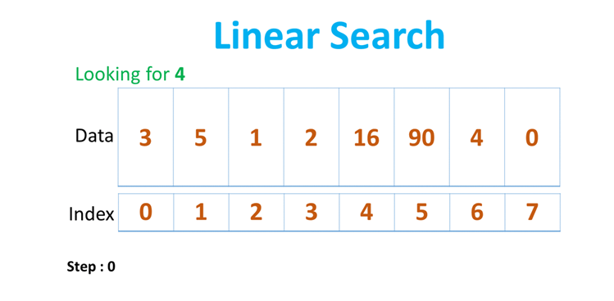
Linear Search
CSE 103 : Structured Programming

Slide 7
Linear Search
CSE 103 : Structured Programming

Slide 8
Binary search

Slide 9
Linear Search
CSE 103 : Structured Programming
Binary Search is defined as a searching algorithm used in a sorted array by repeatedly dividing the search interval in half.

Slide 10
Binary Search
CSE 103 : Structured Programming

